Slide 1
CanBus basics
By Robert Leale of CANBusHacks
Edited by Dave Quinton-Schein of figmentofimagination Productions

Slide 2
Vocabulary
CAN: Controller Area Network
Bus: a type of network where multiple devices transmit on the same physical medium
ECU/ECM: Electronic Control Unit/Module: a small, stand-alone computer with a specific set of tasks
PCB: Printed Circuit Board
OEM: Original Equipment Manufacturer: the “car company” or the company that makes the parts used by the car company, depending on what part you’re talking about

Slide 3
More Vocab
OBD-II: OnBoard Diagnostics, version 2: USA-mandated connection for all vehicles model year (MY) 1996 and newer
ISO: International Organization for Standardization
SAE: Society of Automotive Engineers
NMEA: National Marine Electronics Association
Tx: Transmitter or Transmitting
Rx: Receiver or Receiving
Noise: electromagnetic interference and/or fluctuating voltage on the bus, which can affect the signal, making 0 look like 1 and 1 look like 0

Slide 4
Why Canbus?
Modern cars have ~70 ECU (Electronic Control Units)
ECU manage air bags, brakes, cruise control, powertrain, etc.
~100 000 000 lines of code (more than the Boeing 787 Dreamliner)
Connected via “central nervous system” called CAN Bus
Controller Area Network
“Multi-master, Broadcast serial bus”
NO central controller for the network itself
Every ECU connected to same “line”

Slide 5
Why CANBUS, continued
ECU communicate via protocols specific to the CAN Bus
Different manufacturers use different protocols
“statements” from one car likely will not work on another model
Watching and capturing network traffic can tell us a lot
Decipher/reverse engineer the captured traffic
Understand the protocol being used
Write our own messages- make the car do what we want

Slide 6
Quick facts
CAN created by Bosch
http://www.semiconductors.bosch.de/media/pdf/canliteratur/can2spec.pdf
Early 1990s
Currently version 2.0B
Transfer near-real-time data in small frames across a harsh and potentially noisy bus
CAN on PCB (Printed Circuit Board)
Microprocessor with one or more CAN Controllers as peripherals
Controller connected to Transceiver
Transceiver connected to physical layer of the bus
Provides bi-directional link between the CAN bus and the microprocessor

Slide 7
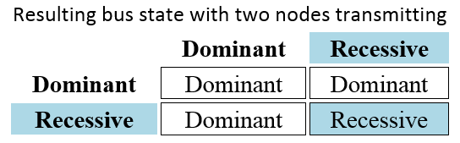
Quick Facts, continued
Dominant/Recessive
0 is Dominant. 1 is Recessive.
Recessive bits are at the same voltage as an idle line (no ECU transmitting)
CAN frame built by stringing together these 0s and 1s.

Slide 8
Physical Layer Protocols
Presently 3 different, main protocols for creating the physical bus:
Dual-wire CAN
Fault-tolerant CAN
Single-wire CAN
All are based on the same concept, but implement it differently

Slide 9
Dual-Wire High-Speed CAN
Specified by ISO (International Organization for Standardization) 11898-2
Most prevalent physical layer protocol
USA federally-mandated OBD-II (OnBoard Diagnostics, version 2) network for MY (Model Year) 2008 and newer
Used in heavy trucks and agriculture via SAE (Society of Automotive Engineers, and your hosts for the CyberAuto Challenge) J1939
Used in marine industry via NMEA (National Marine Electronics Association) 2000 standard

Slide 10
Dual-Wire CAN, continued
DWCAN is a “Differential Bus”
Two, twisted copper wires (a.k.a. “twisted pair”)
One wire called “CAN High”
Other wire called “CAN Low”
Terminated on either end by individual 120-ohm resistors across the CAN high and low wires
Results in net 60-ohm resistance between the wires
Necessary for proper signals
Prevents “signal reflection,” when the signal “bounces back” and interferes with intended signals

Slide 11
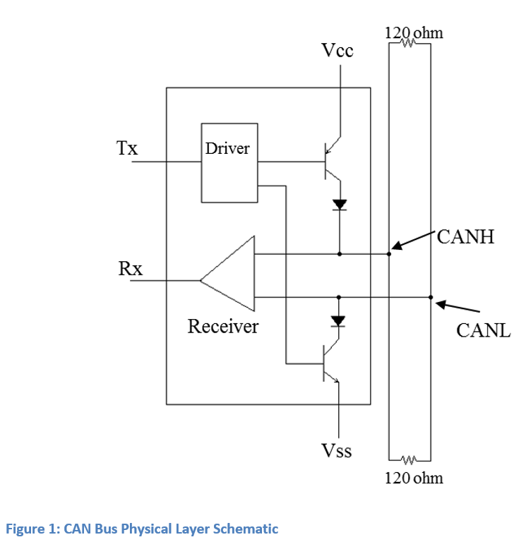
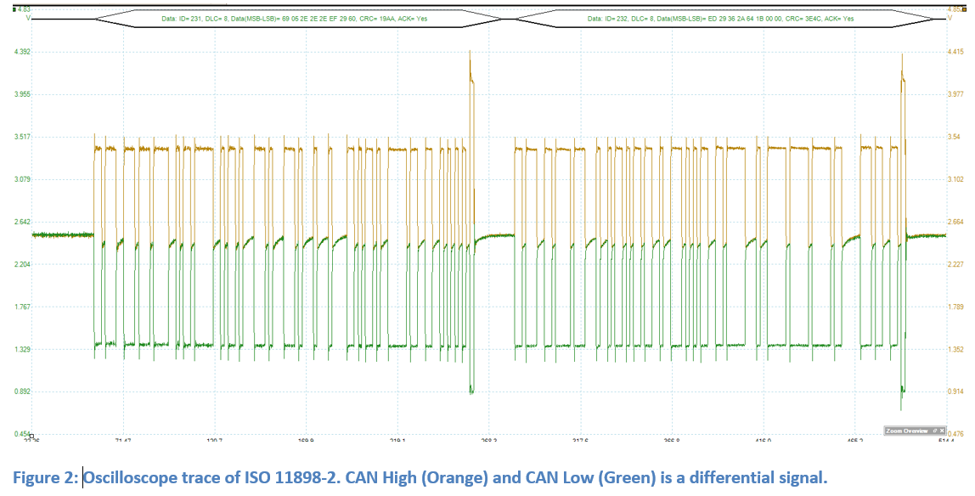
Dual-Wire CAN, continued
Voltage
“Idle voltage” typically around 2.5 volts
When “active”, CAN-H line will reach around 3.2v and CAN-L line will reach around 1.8v (1.4v difference, or “delta”)
Minimum delta is 0.6v
When this 0.6v delta is true, the bus is Dominant (logical 0)
Else, it is Recessive (logical 1)

Slide 12
Single-Wire CAN
SAE J2411
Low cost alternative to ISO 11898-2
Only today used by GM
SWCAN had been used by Honda for several years
NOT “differential” like 11898-2
Signaling voltages of 0v at Idle and recessive (logical 1)
5v for dominant bits (logical 0)
High Voltage mode to “wake up” nodes that are in low-power state
Any message greater than 9v
Typically use “vbatt” (battery voltage)
Ensures low-power state nodes are able to ignore normal data

Slide 13
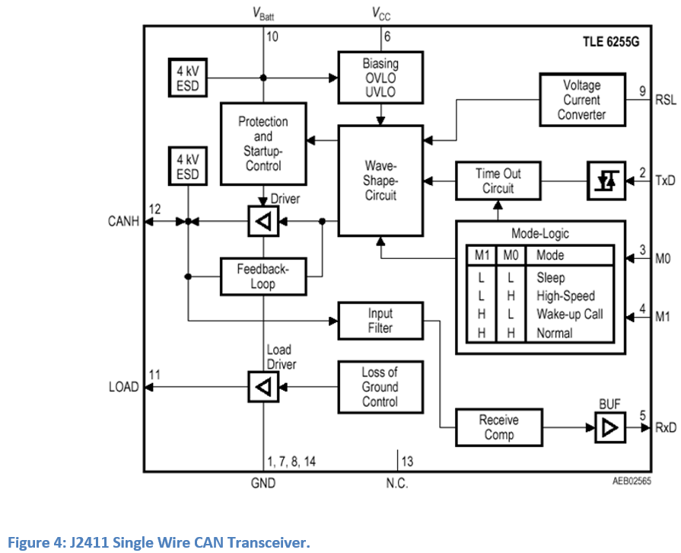
Single-Wire CAN Schematic

Slide 14
Fault-Tolerant CAN
ISO 11898-3
Lower-speed, fault-tolerant alternative to ISO 11898-2
FTCAN can sustain a severed line
Network recovers to a single-wire topology without modifying any network parameters
Some OEM are moving away from FTCAN (such as Chrysler and Daimler)
Others, like Fiat and Hyundai, continue to support it

Slide 15
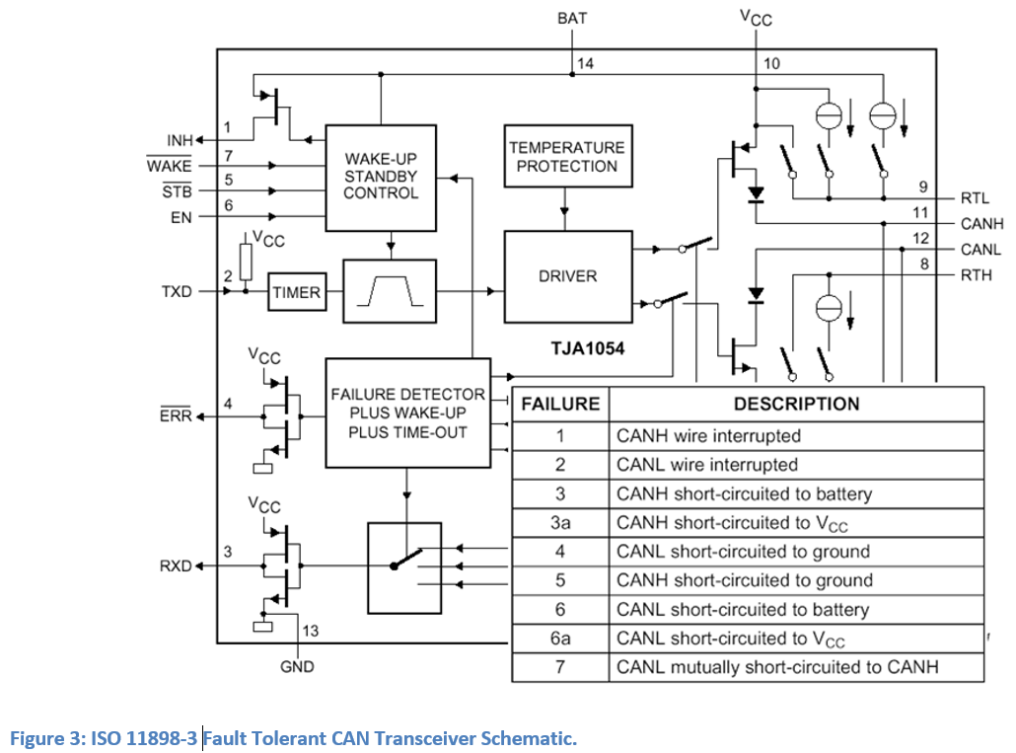
Fault-Tolerant CAN Schematic

Slide 16
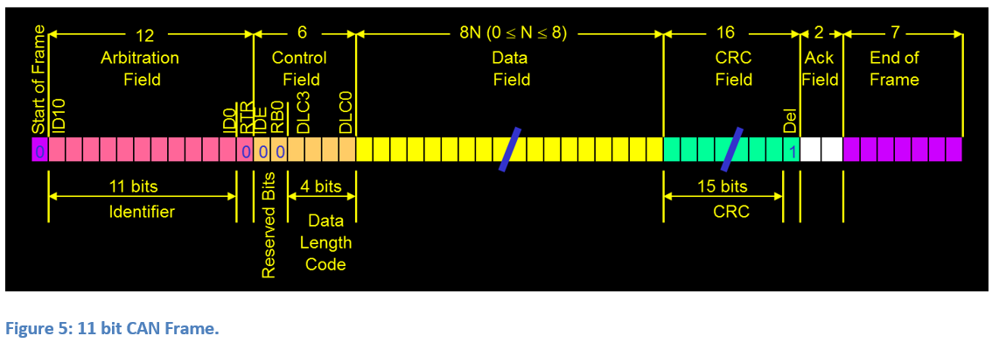
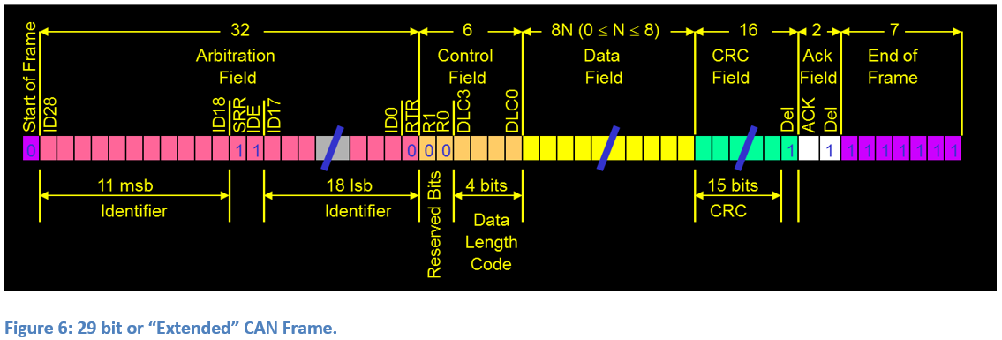
CAN Frame Formats (unique to CAN, not borrowed from previous networks
Unique frame format that seems not to borrow from previous network types

Slide 17
CAN Frame Fields and Default Values
SoF (Start of Frame)
1 bit
Denoted by a Dominant Bit on the CAN Bus
Arbitration Field
For CAN Bus 2.0A or 11 bit frames, the Arbitration field is 12 bits in length
11 bits of ArbID (Arbitration Identification)
1 bit of RTR (Remote Transmit Request)
1 denotes “Remote Frame”
0 denotes “Data Frame”
See Frame Types for more information

Slide 18
CAN Fields and Default Values, Continued
Arbitration Field
For CAN Bus 2.0B or 29 bit frames, the Arbitration field is 32 bits in length
29 bits of ArbID
First 11 ArbID bits at the start
12: SRR (Substitute Remote Request) bit, set to 0 by default
13: IDE (Identification, Extended) bit denotes that this is an Extended ID message
Set to 1
14-31: next 18 ArbID bits
32: RTR

Slide 19
CAN Fields and Default Values, Continued
Control Field
2 reserved bits (R0 and R1) for backward compatibility in future versions
Set to 0
4 bit DLC (Data Length Code)
Describe total number of bytes in a Data Frame
Can be used for anything in a Remote Frame
Data Field
Maximum of 8 bytes of data
CRC (Cyclic Redundancy Check) Field
16 bit with 2 sections
Explained more in “CAN Bus Robustness”
1-bit delimiter give a brief delay to calculate CRC and compare

Slide 20
CAN Fields and Default Values, Continued
ACK (Acknowledgement Field)
ACK and ACKd
Receiving nodes send an “OK” to the Transmitting node
Tells Tx node that there is at least one Rx node
Confirms CRC
Defined as a dominant bit
All nodes are required to acknowledge, regardless of intended recipient
Otherwise, must send Error Frame
ACKd is a recessive bit
All nodes must remain idle
If dominant, violates ACKd rules and all nodes must send an Error Frame

Slide 21
CAN Fields and Default Values, Continued
EoF (End of Frame)
Section of idle time
No node allowed to send data
Allows time for error frames
8 bits long
Inter-Frame Space
3 bits of time
Including 8-bit EoF, allows 11 bits of time between frames

Slide 22
Bit Timing and Sampling
“Bit Timing” includes “bit width,” “time quanta,” “sync,” “propagation segment,” and “Phase Segments” 1 and 2.
Bit timing serves several purposes, such as resynchronization and sample-point position
Because multiple physical layer protocols exist, need some method for determining the best sample point for a particular baud rate and medium
Each bit is divided into smaller parts called TQ (Time Quanta)
Each TQ is essentially a place-holder or clock cycle; it’s a measure of a length of time

Slide 23
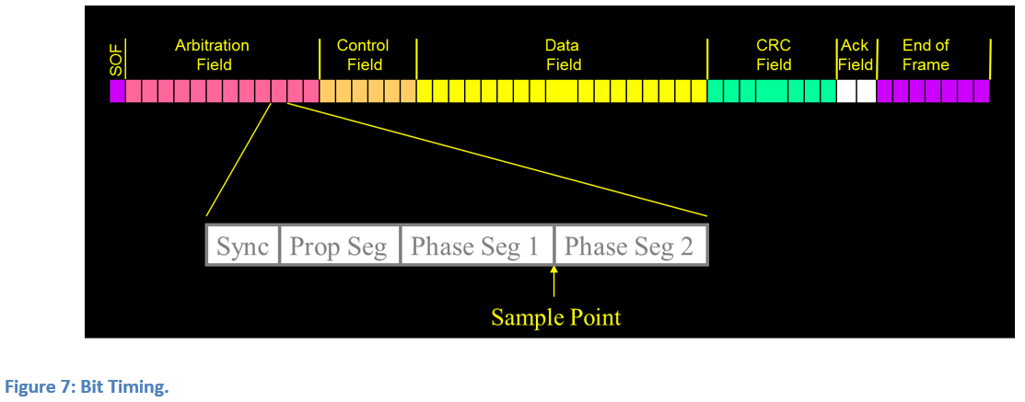
Bit Timing and sampling, Continued
Each bit has 4 parts:
Sync
1 TQ in length
Adjusted by special registers in the processor
PropSeg
1-8 TQ
Phase Seg 1
1-8 TQ
Phase Seg 2
1-8 TQ
Sample Point located between PhSeg1 and PhSeg2
This is where the controller determines Line State (dom or rec)

Slide 24
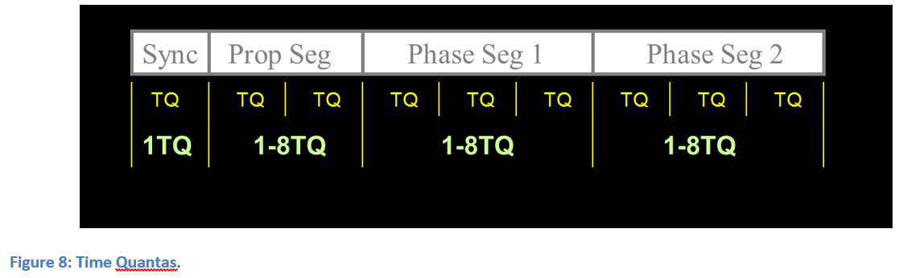
Bit Timing and sampling, Continued
Each device on the bus must have the same timing, to avoid errors
Not possible to just guess the timing; must have documentation of original design

Slide 25
Bit Timing and sampling, Continued
Re-Synchronization
Since no clock line, CAN Bus must be resynchronized often
Bit Stuffing
CAN Controller inserts a bit into the frame whenever there have been 5 bits of a single state (dom/rec)
Bit is of opposite state, ensuring transition on the line
On any transition, the CAN Controller can re-synch its clock with the others
Similarly, the stuff bit is removed by Rx controllers
Jump width
Rules determine how many TQ (forward or backward) the controller is allowed to adjust
Noisy/harsh environments will usually require a higher Jump Width number

Slide 26
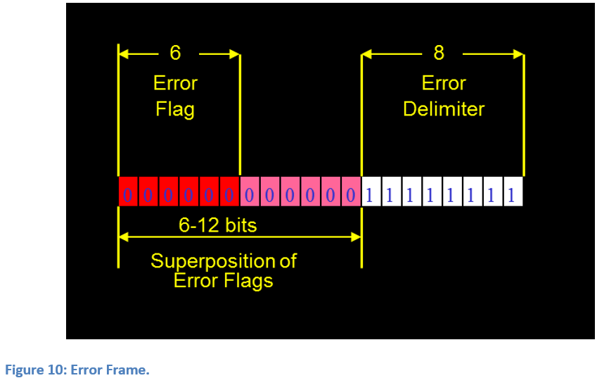
Frame Types
Data
Workhorse of CAN- appx 99.999% of all frames
11-bit or 29-bit
0-8 bits of data
Remote
Similar to Data
Contain no data
Never used in Automobiles
Rarely ever used, since Data frames can have 0 bits of data
Error
6 dom bits followed by 6-12 rec bits
Sent by Tx or Rx node whenever a violation in CAN rules
Interrupts messages in progress
Should not be common on proper wiring with proper controllers

Slide 27
Modes of Fault Containment
Isolate faulty hardware to reduce impact
Error Active
If Rx or Tx node detects an error, sends an “Active Error Frame” as described in Frame Types
First 6 bits are dominant
Upon transmission of Error frame, node will increment a counter
TEC (Tx Error Counter)
REC (Rx Error Counter)
REC/TEC greater than or equal to 127 triggers a new state: Error Passive
TEC decrements upon successful transmission of CAN frame
REC decrements upon successful receipt of 11 recessive bits

Slide 28
Modes of Fault Containment, Continued
Error Passive
When REC or TEC reaches or exceeds 127, node enters Error Passive State
If Rx or Tx node detects error, sends Passive Error frame
First 6 bits are *recessive*
Impossible to detect, since effectively simply idle
Internal counters increment
If errors continue, TEC will increment until reaching 255
Node then set to “Bus Off”
Only restored via software reset

Slide 29
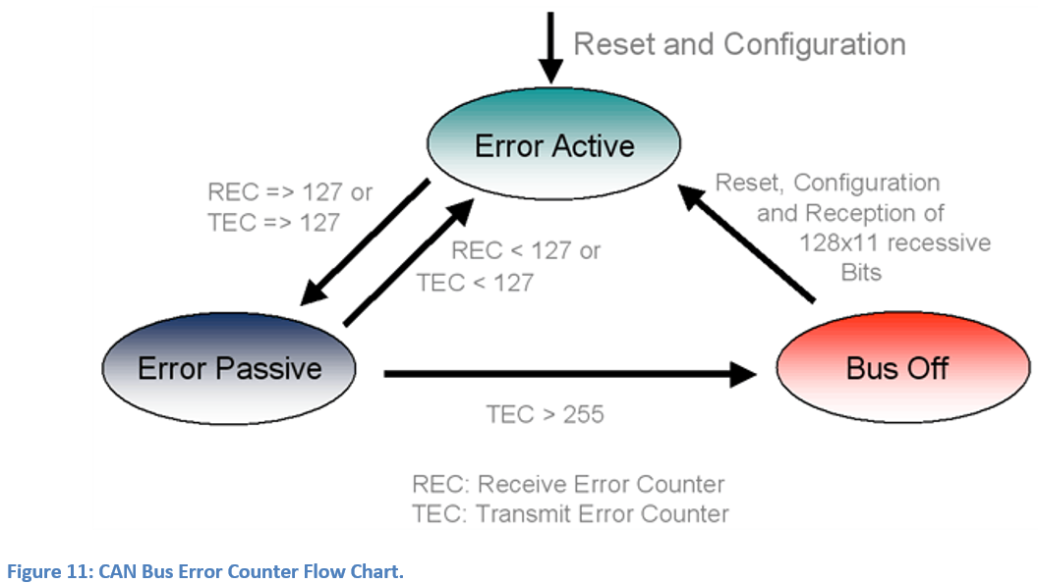
Modes of Fault Containment, Continued
Bus Off
Module not allowed to receive or transmit
Generally triggered by physical hardware issues on device or connection
Not a desirable state
Requires software reset

Slide 30
CAN Bus Robustness
CRC (Cyclic Redundancy Check)
Uses CRC-15 (0x62CC Reversed Reciprocal)
Expects errors to occur
Catches errors when they occur
Rx Nodes also calculate CRC for verification
Error frame may indicate mismatched calculation of CRC
Error Frame triggers re-send of message
All Rx nodes will drop previous message

Slide 31
Media Access Control
CAN Bus uses CSMA/CD (Carrier-Sense, Multiple-Access/Collision Detection)
Multiple-Access
Any node can start a frame
Carrier-Sense
Nodes check for an available medium before transmitting
Means different things in different physical layer protocols
Collision Detection
Senses if another node is transmitting at the same time- called a “collision”
Must determine which node gets to continue transmitting
Called “Arbitration”

Slide 32
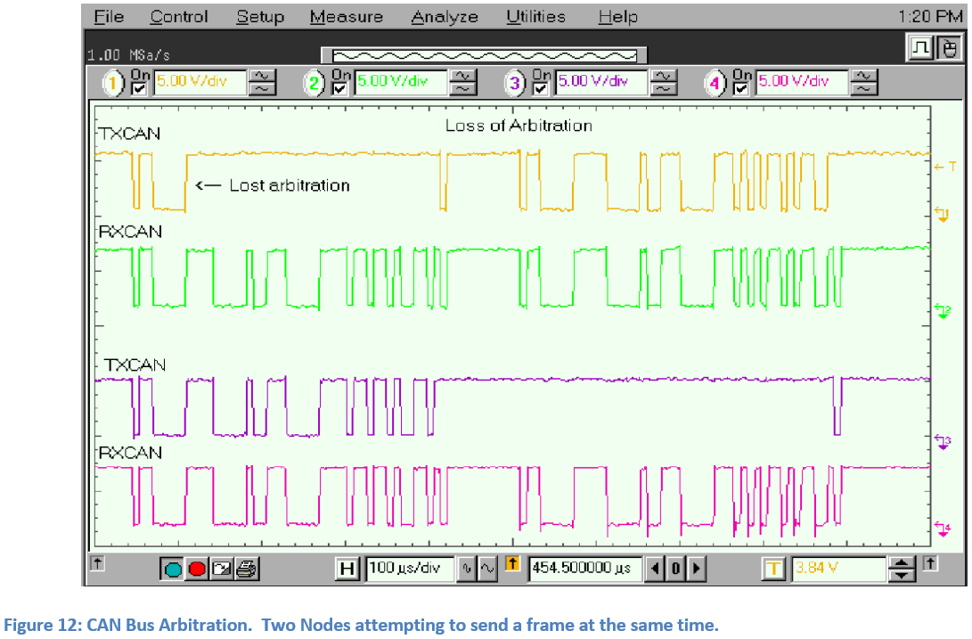
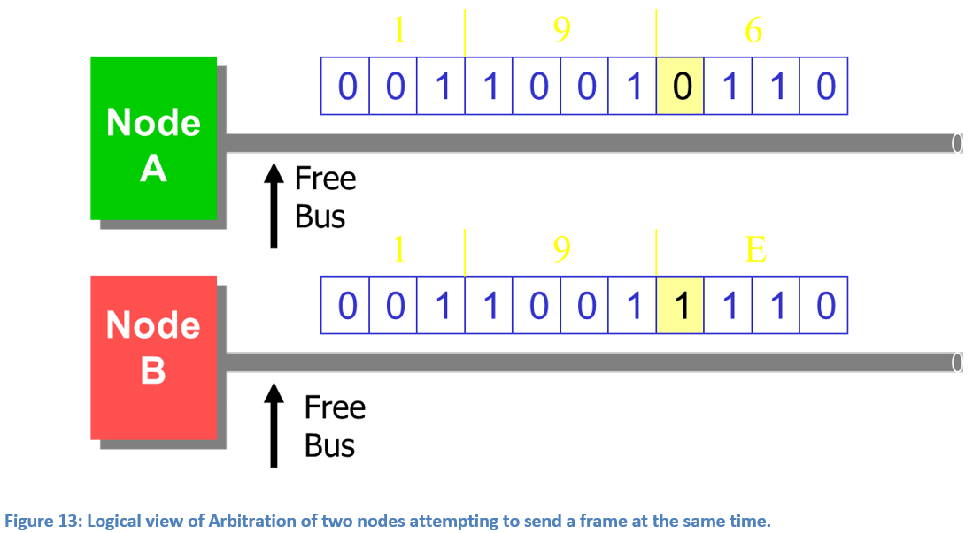
Arbitration
Node with the lower ArbID will not notice the collision
Node with higher ArbID will observe collision and stop transmitting, switching to receiving
Lower ArbID is Higher Priority
Lower priority frame must wait to re-transmit

Slide 33
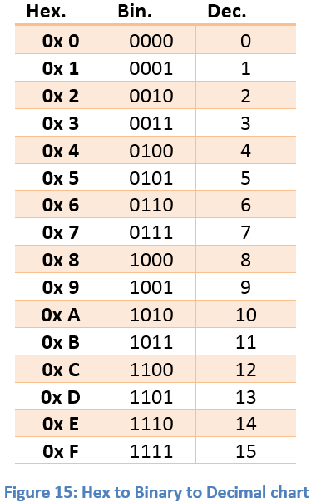
Understanding Hexadecimal Numbers
CAN messages use base16 or “Hexadecimal” numbers
While “Decimal” numbers use 0-9 as numerals (10 in total), “Hexadecimal” numbers use 0-9 and A-F as numerals (16 in total)
Customary to use “0x” in front of the values to indicate hex
0xD would represent the hex value of “D,” or “13”
One hex digit represents 4 binary bits, thus half a byte, and is called a “nibble.”
To complete the bite, two hex values are used

Slide 34
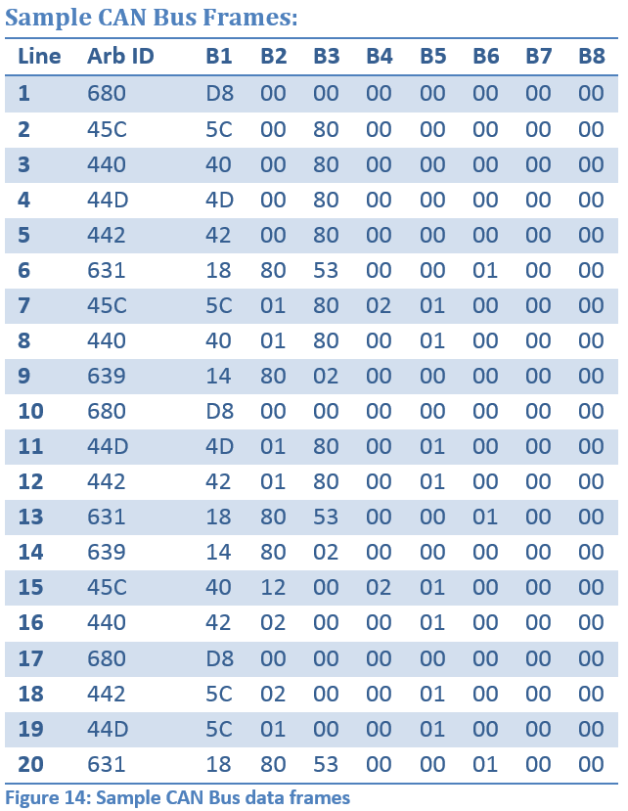
Sample CAN Bus Frames
Line 1 has a value of D8 in Byte 1
1101 1000 in binary
Bytes can represent 0-255, so 0xD8 can mean 216
OR it could be 0xD = 13 and 0x8 = 8
OR it could have no decimal meaning at all
If these data represent, say, an odometer reading, then the hex value will represent a decimal number.
If these data represent the status of a driver door (open or closed), then it probably only uses a single bit within that byte
There are hundreds of ways to represent vehicle data using hex… …and all of them will be used.
Solving this puzzle is part of the fun of reverse engineering.

Slide 35
Recap
CAN is a way for multiple modules to talk to each other on a shared network
0 (dominant) over 1 (recessive)
Three Physical Layers:
Dual wire (differential), Fault-tolerant, single-wire (non-differential)
Two frame lengths:
11-bit and 29-bit around data field
Same Data field size: 0-8 bytes (0-64 bits)
Seven Frame Fields
Start of Frame, Arbitration, Control, Data, CRC, Acknowledge, End of Frame

Slide 36
Recap, Cont
Timing controlled within bits and between frames
ReSyncing achieved via bit stuffing
Nodes adjust by *up to* the jump width
Jump width usually greater on noisy networks
Three modes of fault containment:
Error Active, Error Passive, Bus Off
Uses CRC-15 for data verification
Failed CRC confirmation results in error frame
ArbID used to determine priority on the bus
LOWER ArbID = HIGHER priority

